Slide 1
Agenda
Introduction to Operating Systems
Linux Introduction)
Open-Source
Distributions
File Systems
Kernel – important parts of the kernel
Linux Vs Windows
Virtualization – why?

Slide 2
5W1H in practice
Question yourself around the topics you’re learning
Example:
what
how
where
What is Linux? Where is Linux used? When to use Linux?
Why should I learn Linux? Who developed Linux?
How in real world Linux gained popularity?
5w1h
who
when
why

Slide 3



Introduction to Operating Systems
Scenario 1
I have a bare-metal
I want you to open google chrome and access facebook.com
Solution
Install OS Install Drivers
Connect to Internet
Download Chrome Access facebook.com
An operating system (OS) is system software that manages computer hardware, software resources, and provides common services for computer programs.
(source: Wikipedia)
What are Application Programs?

Slide 4
Linux Operating System
What is Linux?
An Open-Source operating system and community developed operating system for computers, servers, mainframes, mobile devices and embedded devices.
Ubuntu, Debian, Fedora, OpenSuse, Redhat, Android etc.,
https://www.linuxvmimages.com/
What is Unix?
Unix is an operating system that is installed only on specific hardware
Unix developed for multi user and multi tasking purposes in mid 1970s
Unix mostly used by Sun Solaris and supports only few file systems
IBM AIX, Solaris, HP-UX, Darwin, macOS X, etc.

Slide 5
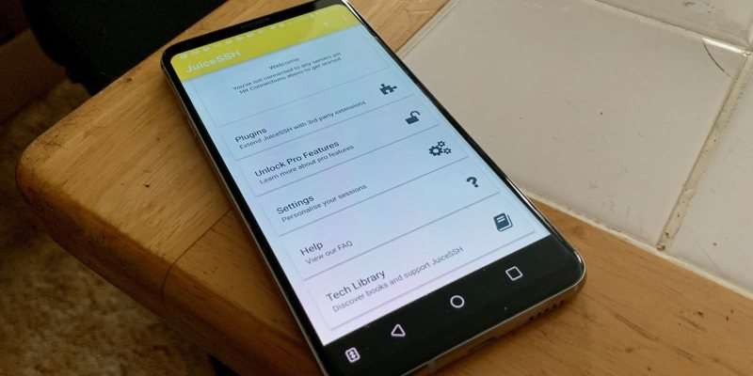

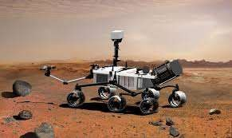

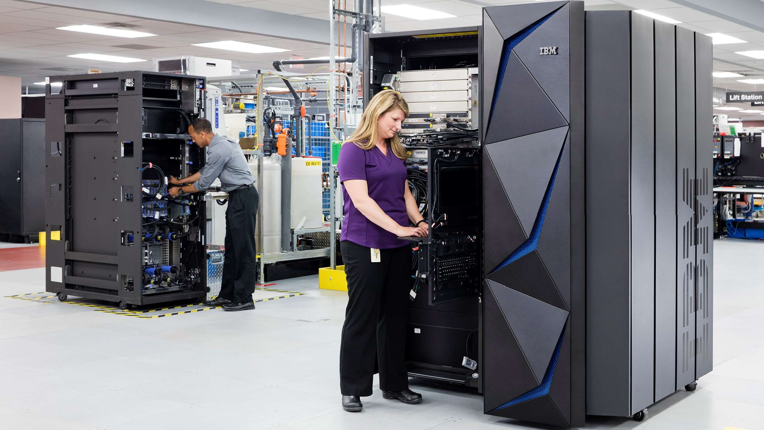
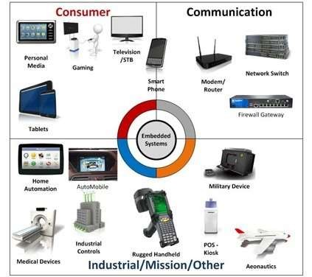
Where do we find Linux?
https://blog.netdevgroup.com/2016/12/25-cool-linux-facts/

Slide 6

Who developed Linux?
Linus Torvalds, developed the kernel.
https://en.wikipedia.org/w iki/Linus_Torvalds
Who uses Linux?
US Govt, NASA, Metro Rails, Traffic Control,NYSE, Amazon, fortune 500, and the list goes on……

Slide 7
Why Linux?
Price – Free
Ease – Not user friendly
Reliability – runs for years
Software – Mostly Enterprise level Software
Multi Tasking – Best for Multi Tasking
Security – Very Secure
Open Source – Yes! Lot of distributions
A must read
https://blog.netdevgroup.com/2016/12/25-cool-linux-facts/

Slide 8
Infrastructure
Advertising Campaigns
Company Registration process
Security Deposits
Operating System Licensing
Application Software Licensing
How Linux benefits me?
Scenario: a startup company with a team of 10 members
Application Development Web Development
Data Analytics
Software auditing happens!
Solution : somehow if we can replace Licensing cost, that would add some benefit.
How? – Linux Operating System and Opensource Tools

Slide 9
Open-Source Vs. Licensed
What is Open-Source
community developed operating system
Kernel Programming
Contribute to the community
Different Communities
Distributions: https://www.linuxvmimages.com/
Licensed
Enterprise Versions
Windows
Mac

Slide 10

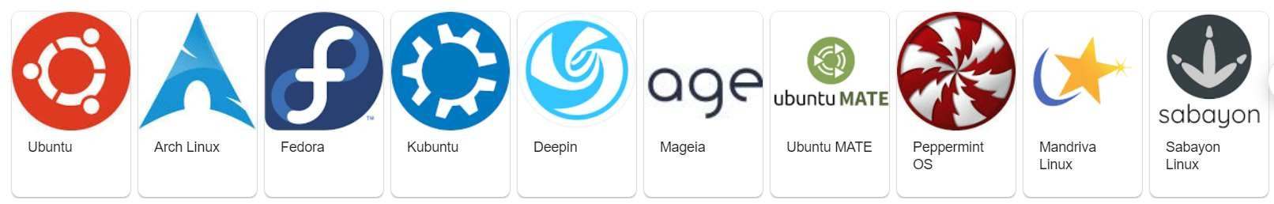
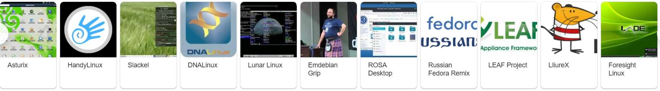
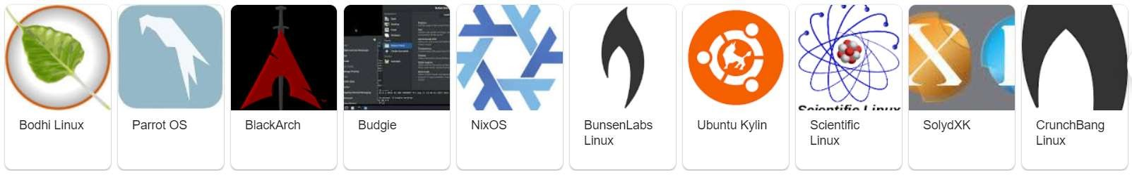
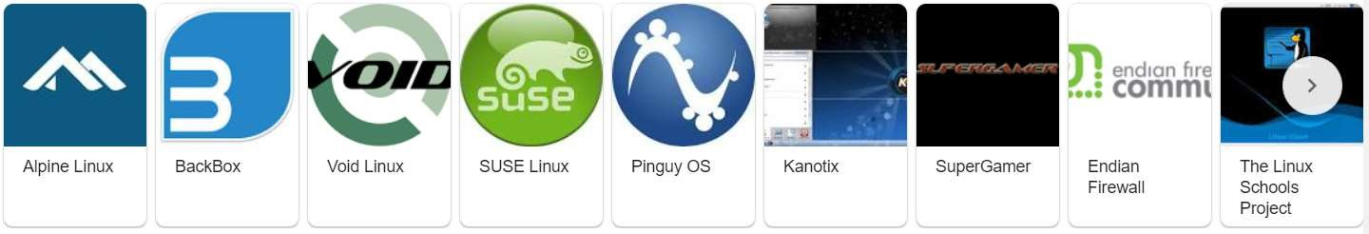
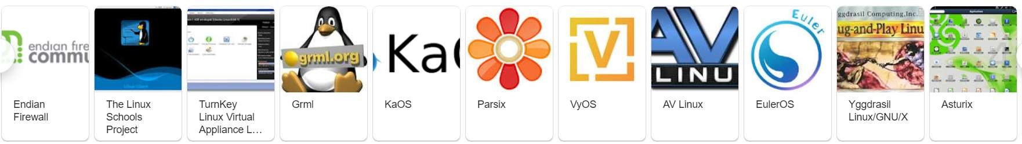
Distributions (distros)

Slide 11
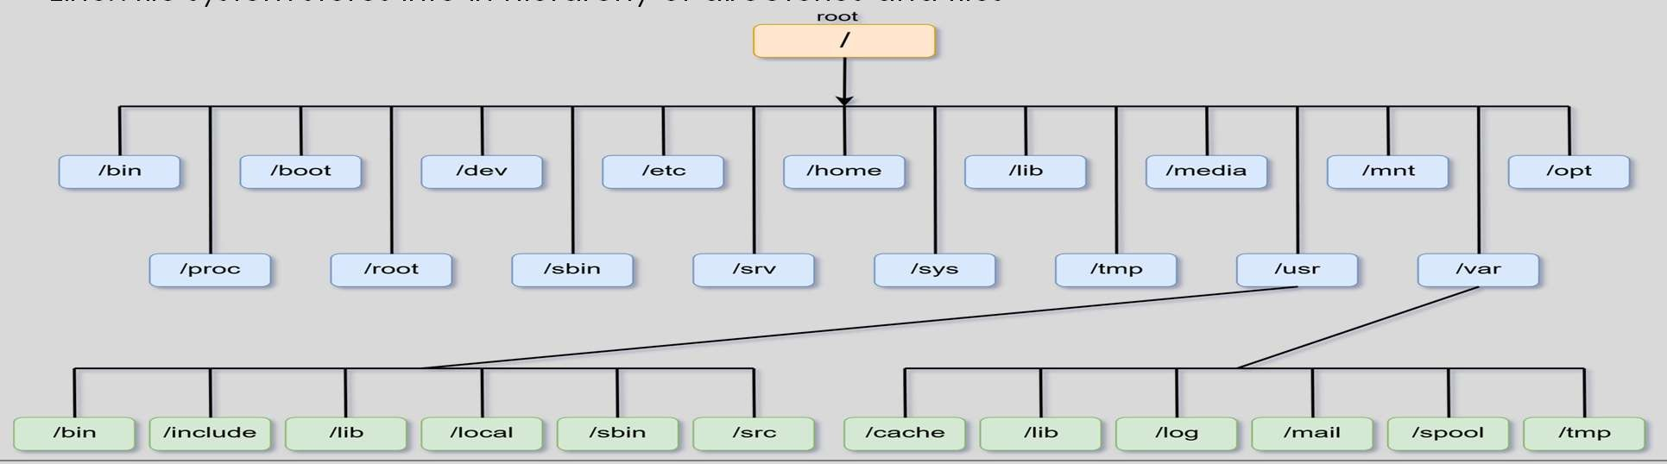
File System
Linux treats everything as a file
Every operating system stores data on Disk Drives using structures called a file system.
The file system consists of files, directories and info needed to access and locate them
Different types of file systems : EXT2, EXT3, XFS, windows: NTFS, FAT32
Linux file system stores info in hierarchy of directories and files

Slide 12

/boot : contains file that is used by the boot loader (grub.cfg)
/root : root user home directory. It’s not the same as /
/dev : System Devices
/etc : Configuration files
/bin: Everyday user commands
/sbin: System or file system commands
/opt: Optional add on apps
/proc: Running processes (only exist in memory)
/lib: C program library files needed by commands
/tmp: directory for temporary files
/home: directory for user
/var: system logs
/run: System daemons that run/ start very early to store tmp runtime files like PID files
/mnt : to mount external file systems (Ex. NFS)
/media: for CDROM Mounts

Slide 13
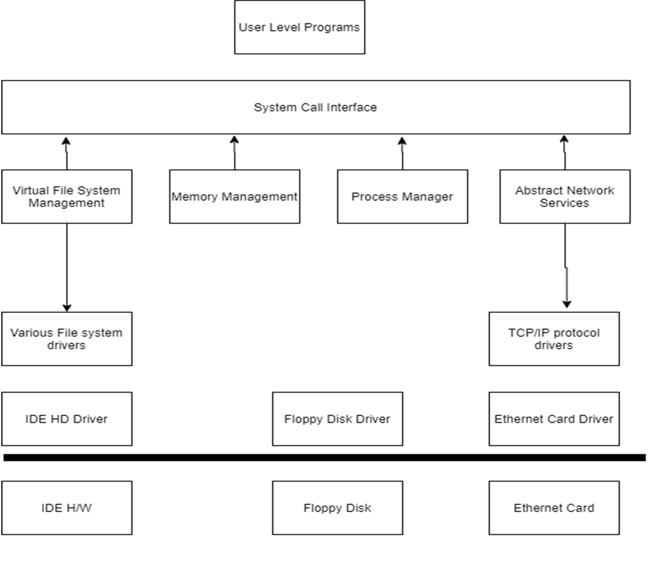
Kernel : important parts of kernel
Process Management
Memory Management
Hardware Device Drivers
Filesystem drivers
Network Management
Various other bits and pieces

Slide 14
Linux Vs Windows
 | Linux | Windows
Price | Free | $$$$
Ease | Not User Friendly | User Friendly
Reliability | Runs for years | Often requires reboot
Software | Mostly enterprise level SW | Much larger selection of SW
Multi Tasking | Best for multi tasking | Available with High CPU/Mem resource
Security | Very Secure | Somewhat secure (3rd party)
Open Source | Open to Public | Not an Opensource

